Slide 1
Capstone Project – Group 8
Restaurant Recommendation and Restaurant Improvement using Yelp Dataset
Team Details
Shobin Joyakin Sonia Mawandia
Nishita Ravindra Vignesh Athavan
Ganapathi Subramanian Nagarajan
Mentor :
Mukesh Rao
Git hub Link: https://github.com/shobinjoy/PGPBDML-Capstone-Group8

Slide 2
Objective
Making a personalized restaurants recommendation based on
User’s preference and their past ratings of the restaurant.
2. Provide Improvement topics to low rated restaurants by doing text mining on all the low rated reviews of the restaurant .

Slide 3
Business Case
i) Today , Users are spoilt for choices because of lot of options and traditional recommendation system will provide a laundry list of restaurants without understanding what is the user preference on a given day
ii) A recent study from Ohio University says 60% of the restaurants close within three years and 80% closes within five years of the opening. There is also a need to come up with strategies that help business sustain in the market by improving their performance by working on the negative points provided by the customers

Slide 4



Dataset
The dataset provided for the Capstone Project is part of the Yelp Dataset Challenge and the specific dataset used in this capstone corresponds to Round 11 of their challenge and can be accessed from the following link for download: http://www.yelp.com/dataset_challenge.
The Yelp Dataset is a subset of business, reviews and users data
Each file consists of a single object type, one JSON-object per line
Yelp aggregates review data from its users and rank restaurants based on them
Size of the Data
5,200,000+ Reviews
54,000+ Restaurants
1,300,000+ Users

Slide 5
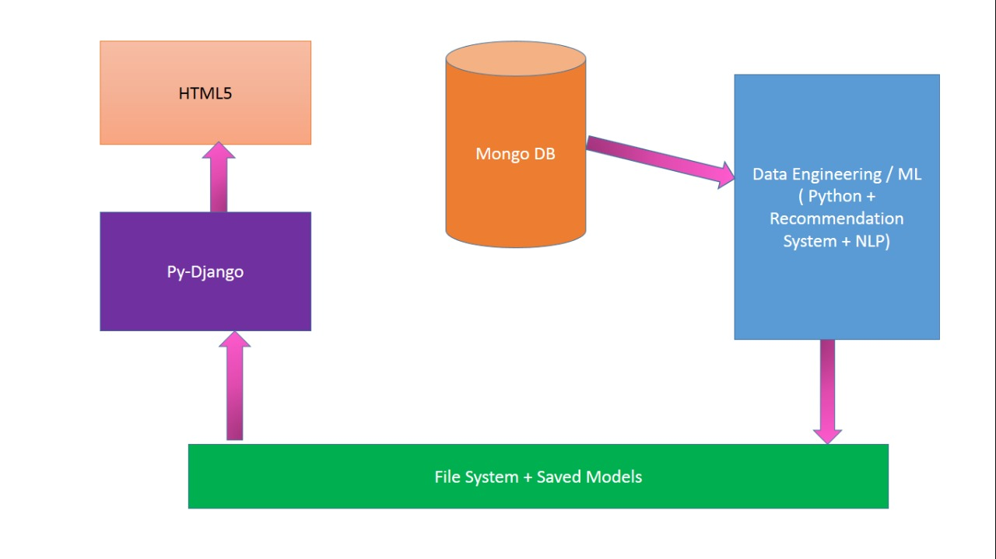
Solution Architecture

Slide 6
Data Pre Processing and EDA
Data Filtering and Consolidation:
The JSON files are filtered to only open restaurants in Arizona that were reviewed between 2013- 2017 in MongoDB.
Flattening of the attributes and categories of the restaurants into individual columns
255 categories that are not relevant to restaurant cuisines like ‘category_Active Life ’, ‘category_Day Spas’, ‘category_RV Repair ’ etc.., were removed.

Slide 7
Data Pre Processing and EDA
Our dataset contains 7367 restaurants with 276 features.
As part of data cleaning, we have done the below mentioned steps
Features with lesser importance that had no impact on the dataset like ‘HairSpecializesIn_coloring’, ‘BYOBCorkage’, ‘AcceptsInsurance’ etc.., were removed.
Handled the NaN values for all columns other than ‘business_id’, ‘name’, ‘address’, ‘city’, ‘state’, ‘postal_code’, ‘latitude’, ‘longitude’, ‘stars’ and ‘review_count’ based on their attribute counts.
Cleaned up the irregularities in the restaurant names, postal codes, cities, latitude and longitude attributes with the help of charts plotted in Tableau.
Now we finally have 7365 restaurants with 235 features.
Column Name | Column Values Before Handling NaN | Column Values After Handling NaN | Final Values | Description
Alcohol | ['none', 'full_bar', nan, 'beer_and_wine'] | ['none', 'full_bar', 'beer_and_wine'] | [0, 2, 1] | none: 0, beer and wine: 1, Full bar: 2
RestaurantsPriceRange2 | [ 1., 2., nan, 3., 4.] | [ 1., 2., 0, 3., 4.] | [1, 2, 0, 3, 4] | 0, 1, 2, 3, 4
Smoking | [nan, 'no', 'outdoor', 'yes'] | ['no', 'outdoor', 'yes'] | [0, 1, 2] | no:0, outdoor:1, yes:2
WiFi | ['free', 'paid', nan, 'no'] | ['free', 'paid', 'no'] | [1, 2, 0] | no:0, free:1, paid:2

Slide 8
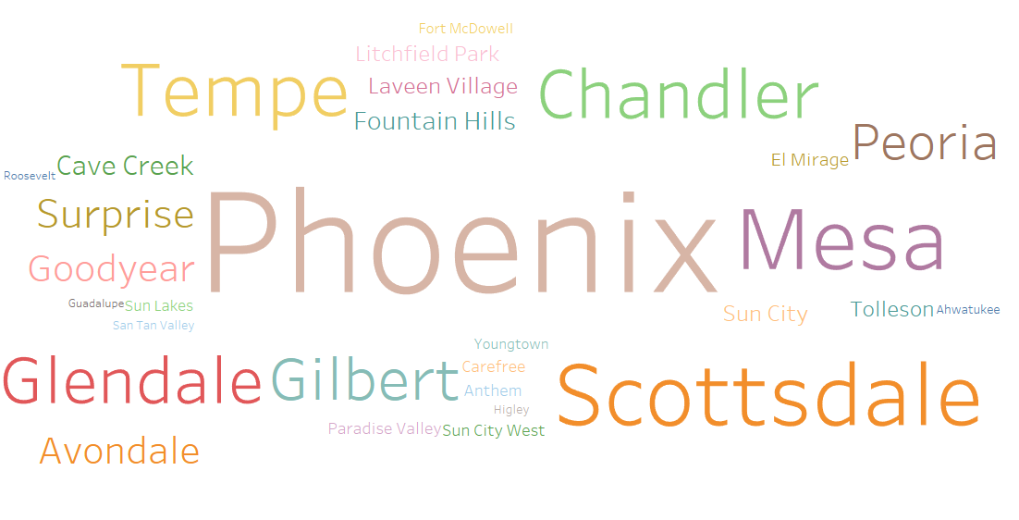
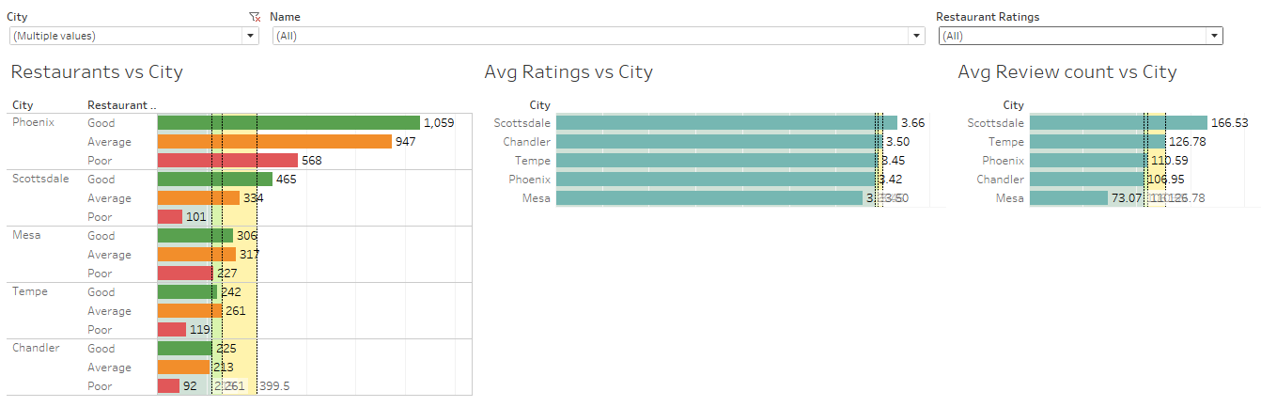
Data Pre Processing and EDA
Word cloud based on number of restaurants in the city
Analysis of restaurants in the top 5 cities

Slide 9
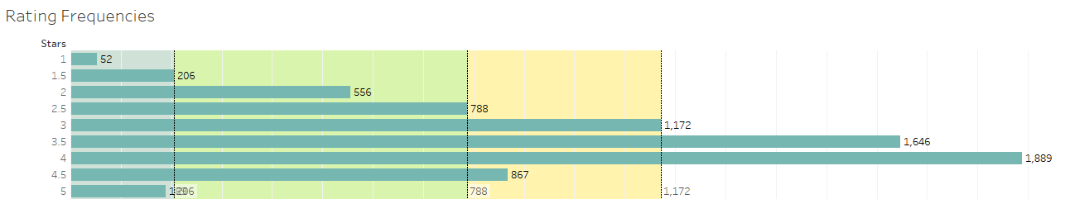
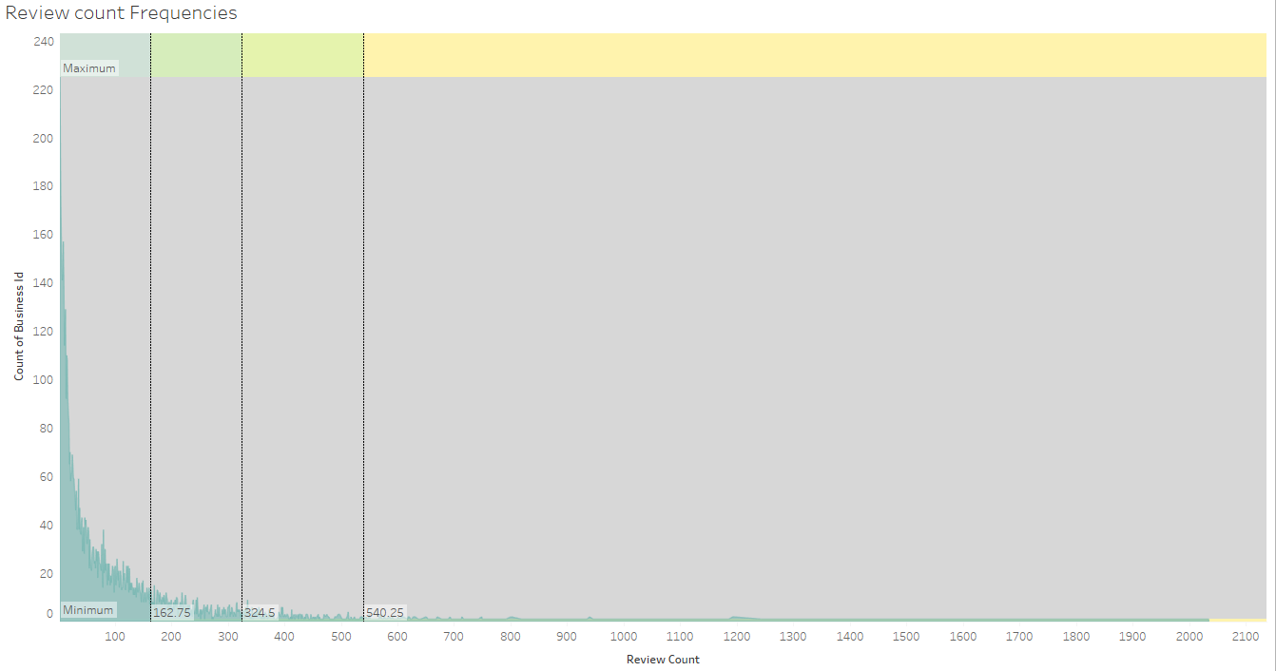
Data Pre Processing and EDA

Slide 10



Recommendation Systems
Age of Information overload and many choices
Recommendation 2 step process
Context - Explicit and Implicit options
Context
Learning Process
Cluster or Model
Decision Process
Recommended
Items
OFFLINE
ONLINE

Slide 11
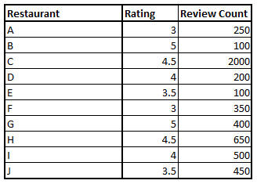
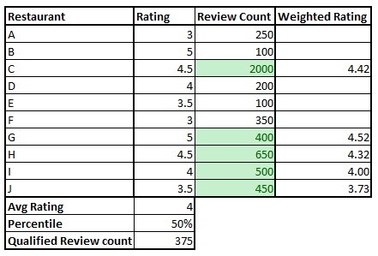
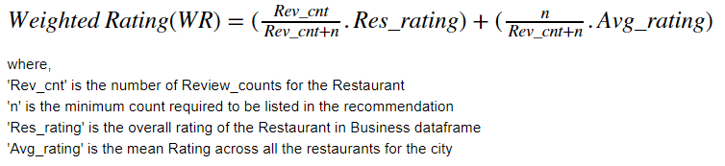
Popularity Based Recommendation

Slide 12

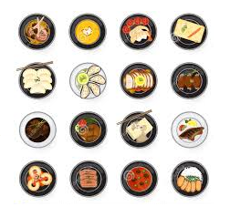
Content Based Search Engine
Restaurant Features
Attributes – Facilities
Categories – Cuisines
Search Engine:
Exact matches for the criteria
Recommender – Nearest Neighbor:
Convert Features to Vectors
Calculate distance between the vectors (Cosine, Pearson’s Correlation, etc)

Slide 13
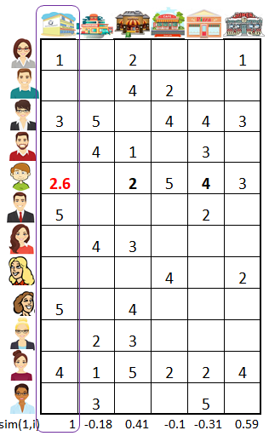
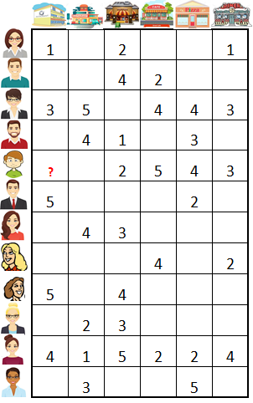

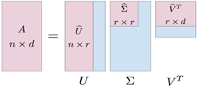
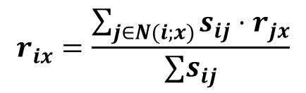
Item Similarity Based Collaborative Filter
Nearest Neighbor Approach (KNN)
Reduced Dimensions (SVD)
$$r_{ix}=\frac{\sum_{j∈N(i;x)}{s_{ij}⋅r_{jx}}}{∑s_{ij}}$$

Slide 14
Model Evaluation – Recommender Systems
SVD – 5-fold Cross Validation
Hyper Parameter selection using Grid Search:
 | Fold1 | Fold2 | Fold3 | Fold4 | Fold5
RMSE | 1.16632661 | 1.1781625 | 1.19805187 | 1.19853795 | 1.20440856
MAE | 0.93165396 | 0.94119723 | 0.94512725 | 0.95047884 | 0.95037895
KNN – 5-fold Cross Validation
 | Fold1 | Fold2 | Fold3 | Fold4 | Fold5
RMSE | 1.36519902 | 1.32256785 | 1.37540035 | 1.35896141 | 1.33197688
MAE | 1.01937273 | 0.97884052 | 1.02052509 | 1.01461168 | 0.98846071

Slide 15
Restaurant Improvements through Text Mining
Review Text Preprocessing
Word Cloud
Identifying the most negative bigrams
Identifying the Topics

Slide 16
Data extraction rules
High rated restaurants:
average rating of 4 and 5.
Only reviews with rating 4 and 5
Low rated restaurants
average rating of 1 and 2.
Only reviews with rating 1 and 2

Slide 17
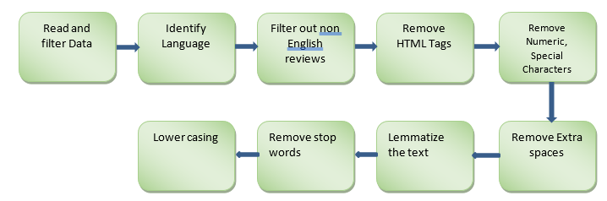
Review Text Preprocessing

Slide 18
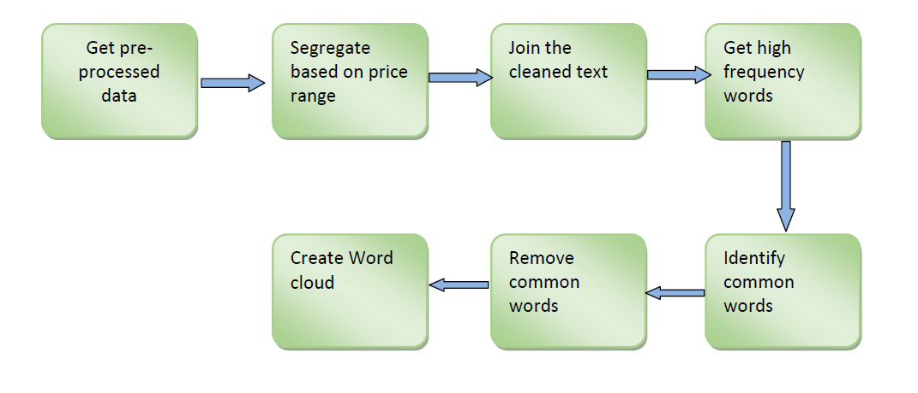
Word Cloud

Slide 19
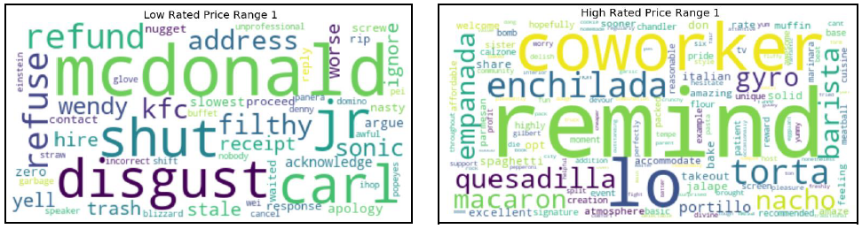
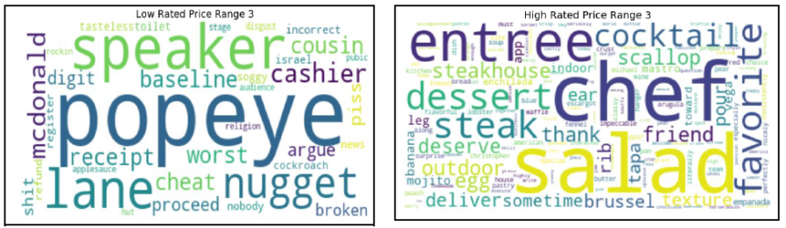
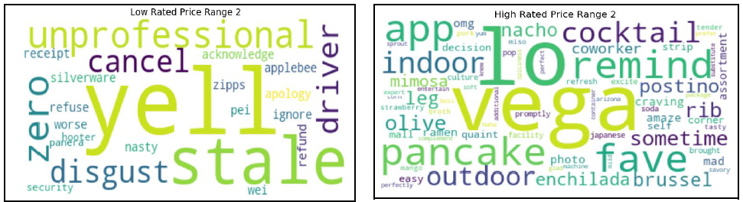
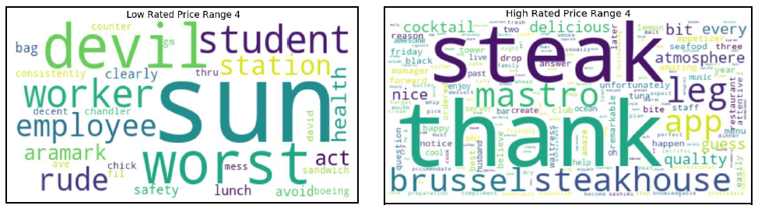
Word Cloud
Price range 1
Price range 3
Price Range 2
Price Range 4

Slide 20
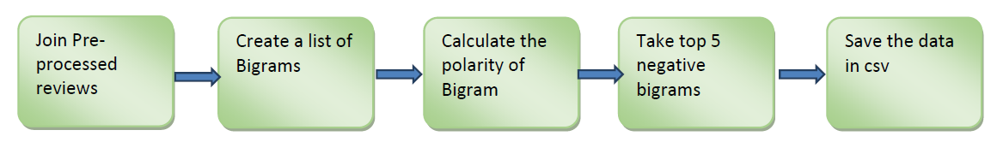
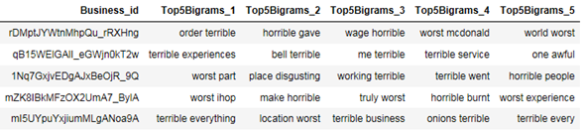
Identifying the most negative bigrams

Slide 21
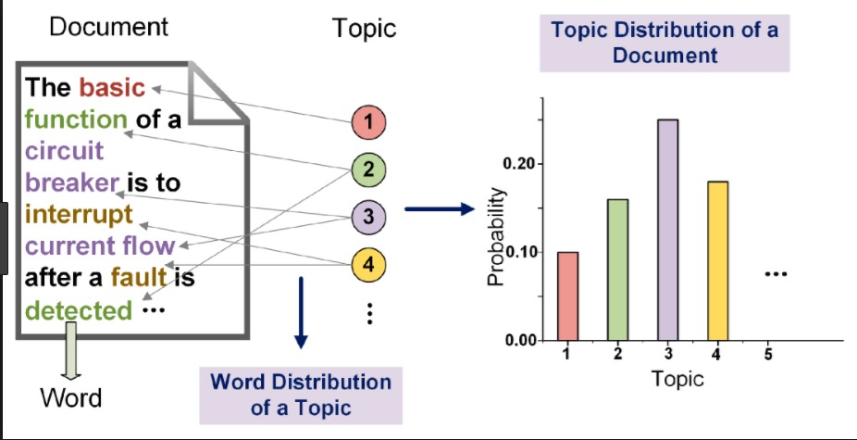
Latent Dirichlet Model

Slide 22
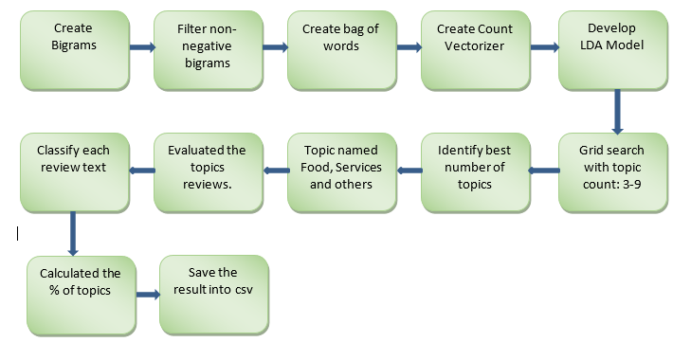
Identifying the Topics

Slide 23
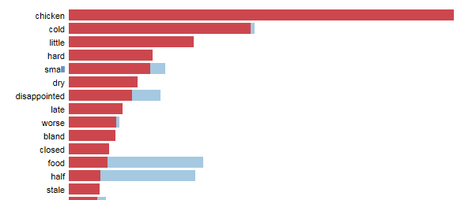
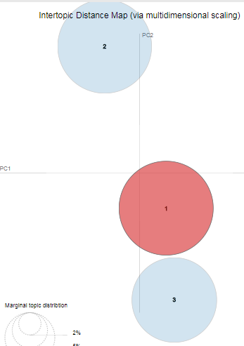
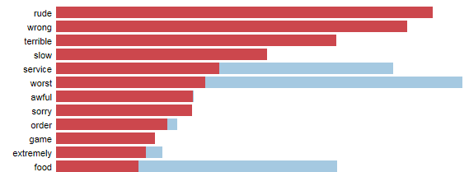
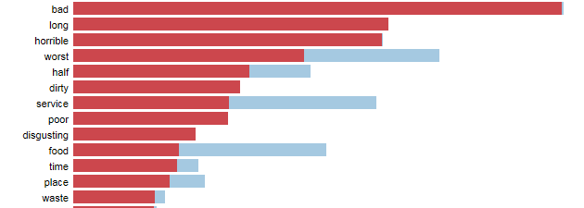
Identifying the topics
Topic clusters
Topic 2
Topic 1
Topic 3

Slide 24
Evaluation
Evaluation of Restaurant Improvements
Grid Search and LDA – All the review text were classified into one of the three topics based on the highest probability score
Manual Evaluation - We randomly took some 110 review text and manually labeled them to be in one of the three topics (Food, Service or others).
The Confusion matrix returned an accuracy score of 67.49%.

Slide 25
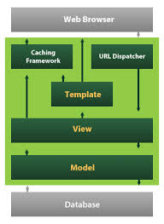
Django ,HTML and Python

Slide 26
Possible Enhancements
Use user’s location and recommend the nearest restaurant based on the preferences and show the directions with the help of Google Maps.
Creating user similarity based recommendation for users who were filtered out based on low review count using user’s profile.
Extend Content based search engine to content based recommendation based on nearest neighbor of the item selected.
In memory processing of recommendation engine using Spark on a larger data.
Add more Filter criteria to search Engine based on clean data being available.

Slide 27
Thanks!

